Slide 1
CREATE SLIDES WITH A BACKGROUND FILL WITH PICTURE
COPY THE OVALS FROM SLIDE 3
ROTATE THE OVALS
SELECT ALL SLIDES AND PUT A MORPH TRANSITION
CHECK THE VIEW ”NOTES PAGE”: you can change the font, spacing,m etc. AND YOU SHOULD DISTRIBUTE THE NOTES PRINTED FOR KEY PERSONS
THIS SHOULD BE THE OPENING SLIDE
Notes:
Put a lot of text in the notes, not in the slides

Slide 2
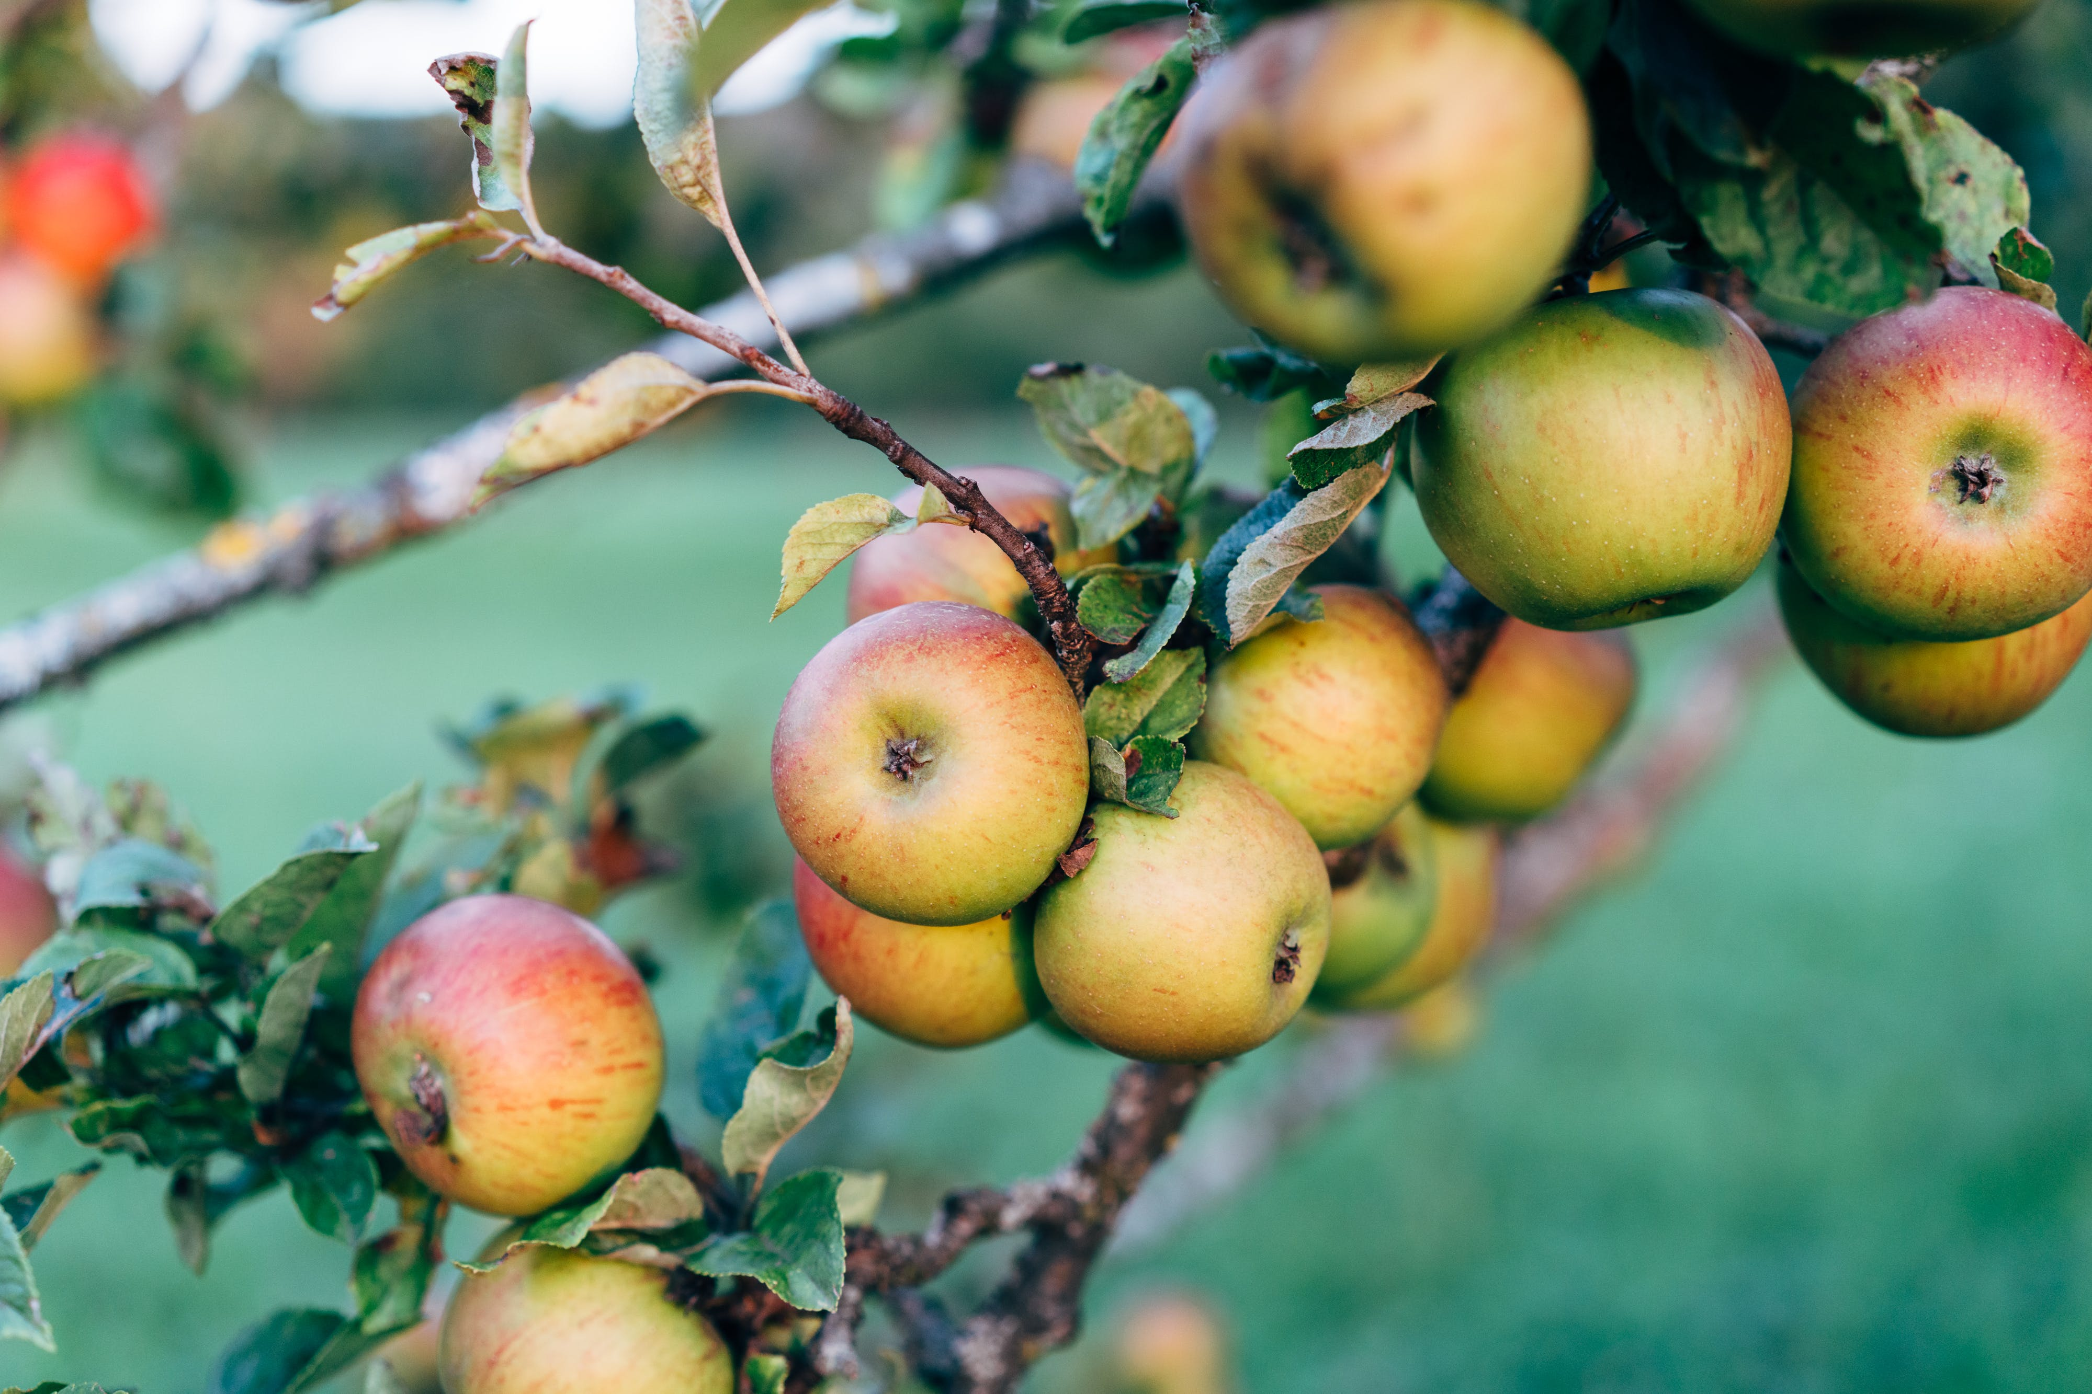
EAT APPLES
BE HEALTHY
GET SOME SUGAR
Notes:
Apples are a widely consumed fruit known for their nutritional benefits and versatility. They come in a variety of shapes, colors, and flavors, and are rich in antioxidants, vitamins, and dietary fiber, contributing to various health benefits such as boosting heart, brain, and digestive health[4][5]. Apples are commonly used to make juice, jelly, jam, and other culinary delights, and are grown in hilly areas, making them a valuable component of a balanced diet[1][4]. With their rich nutrient content, apples are a healthful choice and may help reduce the risk of several conditions, making them a popular and beneficial fruit for many people[4].
In addition to their nutritional value, apples have a rich history and cultural significance. The domestication and cultivation of apples have been a part of human history for centuries, with the fruit being widely grown for various purposes, including fresh consumption, cooking, and the production of cider, vinegar, and other products[5]. The establishment of apples in America was greatly influenced by Johnny Appleseed, who played a significant role in planting nurseries and spreading the cultivation of apples across the country, contributing to the fruit's widespread availability and popularity[3][5]. The diverse uses and cultural importance of apples have solidified their significance beyond just being a tasty snack, making them an integral part of various cuisines and traditions around the world.
Citations:
[1] https://youtube.com/watch?v=l7ihy0ACSzw&t=14[2] https://edubirdie.com/examples/apple-essay/[3] https://www.123helpme.com/essay/Essay-On-Apples-449429 [4] https://www.medicalnewstoday.com/articles/267290[5] https://www.britannica.com/plant/apple-fruit-and-tree

Slide 3
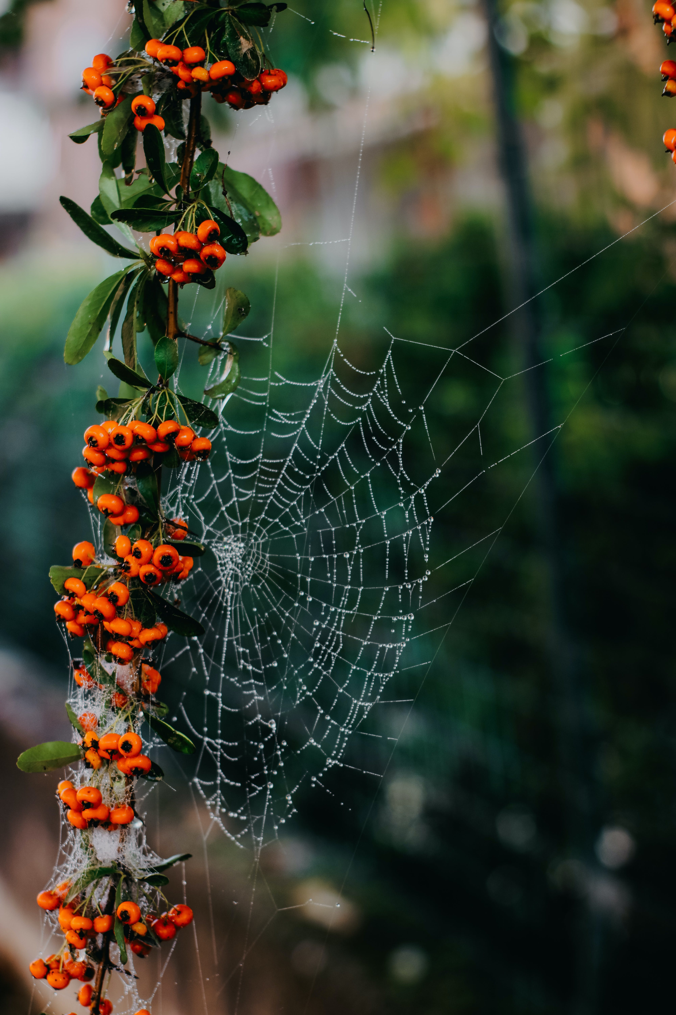
SPIDERS ARE NATURAL ARTISTS
BE CREATIVE
Notes:
Spiders play a crucial role in the ecosystem, serving as both predators and prey and contributing to the balance and health of various environments. Despite their often fearsome appearance, spiders are beneficial in controlling insect populations, which helps to manage the spread of diseases and reduce the destruction of crops by pests[2][3][5]. Their primary niche in nearly every ecosystem involves controlling insect populations, with different species employing various hunting methods, such as web spinning, passive hunting, and active hunting[2]. Spiders also serve as a valuable food source for birds, lizards, wasps, and mammals, further highlighting their significance in the food chain and the broader ecosystem[2].
Moreover, spiders have practical uses beyond their ecological role. Their venom has been found to have potential medical applications, including the treatment of cardiac arrhythmia, Alzheimer's disease, and as a component of pest control materials that are toxic to pests but safe for most other creatures[1][5]. Additionally, spider silk can be spun into a variety of valuable items, such as bulletproof clothing, artificial tendons, and ligaments, showcasing the diverse and beneficial aspects of spiders beyond their role in the natural world[1].
In conclusion, while spiders may evoke fear in some people, it is important to recognize their vital contributions to the ecosystem. From controlling insect populations to serving as a source of medical and technological inspiration, spiders play a multifaceted and essential role in maintaining the balance and health of our environment[3][4][5].
[1] https://www.modernpest.com/blog/spiders-nice-furry-guests-evil-hairy-pests/ [2] https://animals.mom.com/importance-spiders-ecosystem-6242.html [3] https://ridabuginc.com/blog/4-reasons-why-spiders-are-important [4] https://www.britannica.com/animal/spider-arachnid/Importance [5] https://www.earthkind.com/blog/spiders-important-whats-purpose/

Slide 4

TIME FOR CHRISTMAS.
GATHER WITH FRIENDS
Notes:
Christmas parties are a popular way to celebrate the holiday season. They are a great opportunity to gather with friends, family, and colleagues and enjoy the festive spirit. Christmas parties can take many forms, from formal dinners to casual get-togethers, and can include various activities such as gift exchanges, games, and dancing[2][4][5]. Many people also use Christmas parties as an opportunity to give back to their communities by organizing charity events or volunteering their time to help those in need[1][3].
The month of December is often filled with Christmas parties, and they are a great way to spread joy and cheer during the holiday season. Christmas parties can be held at home, in the workplace, or at public venues, and can be tailored to suit different preferences and budgets. They are a great way to connect with others and create lasting memories, and they offer a chance to take a break from the stress of daily life and enjoy the festive season[2][4][5]. Whether it's a small gathering or a large event, Christmas parties are a fun and meaningful way to celebrate the holiday season and spread goodwill to others.
Citations:
[1] https://www.firstcry.com/intelli/articles/essay-on-christmas-in-english-for-class-1-2-3-kids/ [2] https://tjgong.org/my-classroom/response-journal/descriptive-paragraphs-christmas-party/ [3] https://www.ipl.org/essay/Paragraph-About-Christmas-Celebration-PKZUPV74SJPR [4] https://www.aplustopper.com/paragraph-on-christmas/ [5] https://infinitylearn.com/surge/english/paragraph/paragraph-on-christmas/

Slide 5
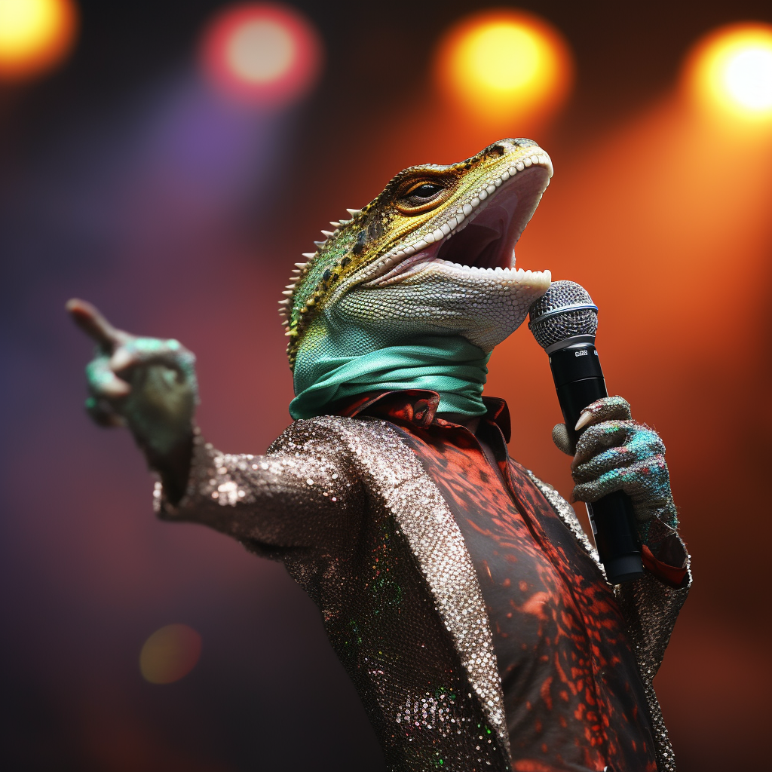
LIZZARD IN A KARAOKE. CAN IT GET BETTER THAN THIS???
Notes:
Karaoke is a form of interactive entertainment that has gained popularity worldwide. It involves individuals singing along to instrumental versions of well-known songs using a microphone. Karaoke can be enjoyed in various settings, including clubs, bars, and private gatherings, and it provides a platform for people to showcase their singing abilities and have fun with friends and family. With the advancement of technology, online karaoke platforms have emerged, offering a vast library of songs for users to choose from, allowing them to enjoy karaoke from the comfort of their homes or on the go[4].
Participating in karaoke can be a source of joy and entertainment for people of all ages. It provides an opportunity for individuals to express themselves through music, bond with others, and create memorable experiences. Whether it's a casual gathering or a lively night out, karaoke has the power to bring people together, uplift spirits, and create a vibrant and engaging atmosphere. Additionally, karaoke has become a popular activity for celebrations and special occasions, adding an element of fun and excitement to events such as birthdays, weddings, and festive gatherings[4].
Citations:
[1] https://edubirdie.com/examples/apple-essay/ [2] https://www.karafun.com [3] https://youtube.com/watch?v=l7ihy0ACSzw [4] https://en.wikipedia.org/wiki/Karaoke [5] https://www.aplustopper.com/paragraph-on-christmas/

